Slide 1

Exploring Football Player Market Value Trends with Age
Alex ekka

Slide 2

Introduction
Objective:
Understanding player valuation in football is crucial for clubs when making decisions about player transfers.
This analysis delves into the intricate relationship between statistical metrics ,skills and market values, offering valuable insights for clubs and enthusiasts alike.

Slide 3
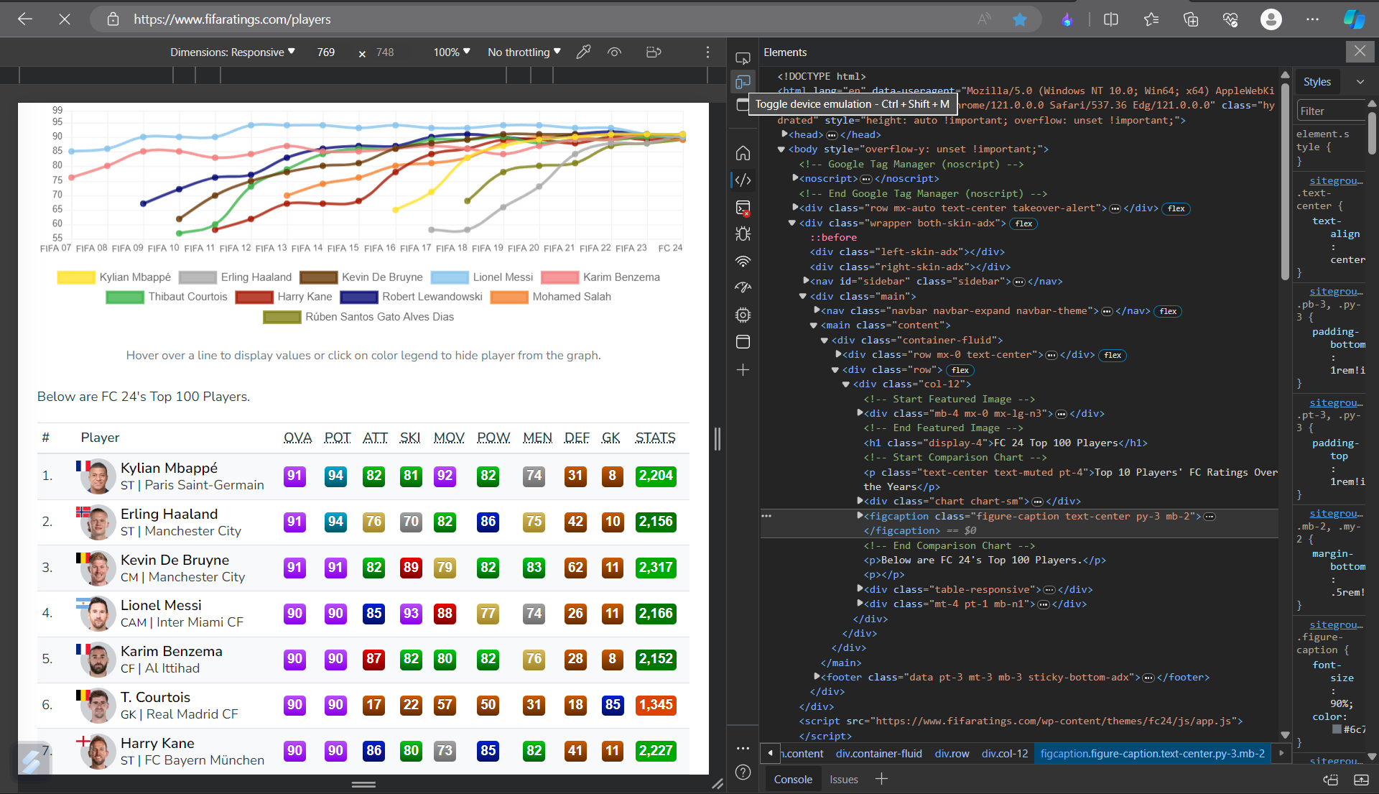
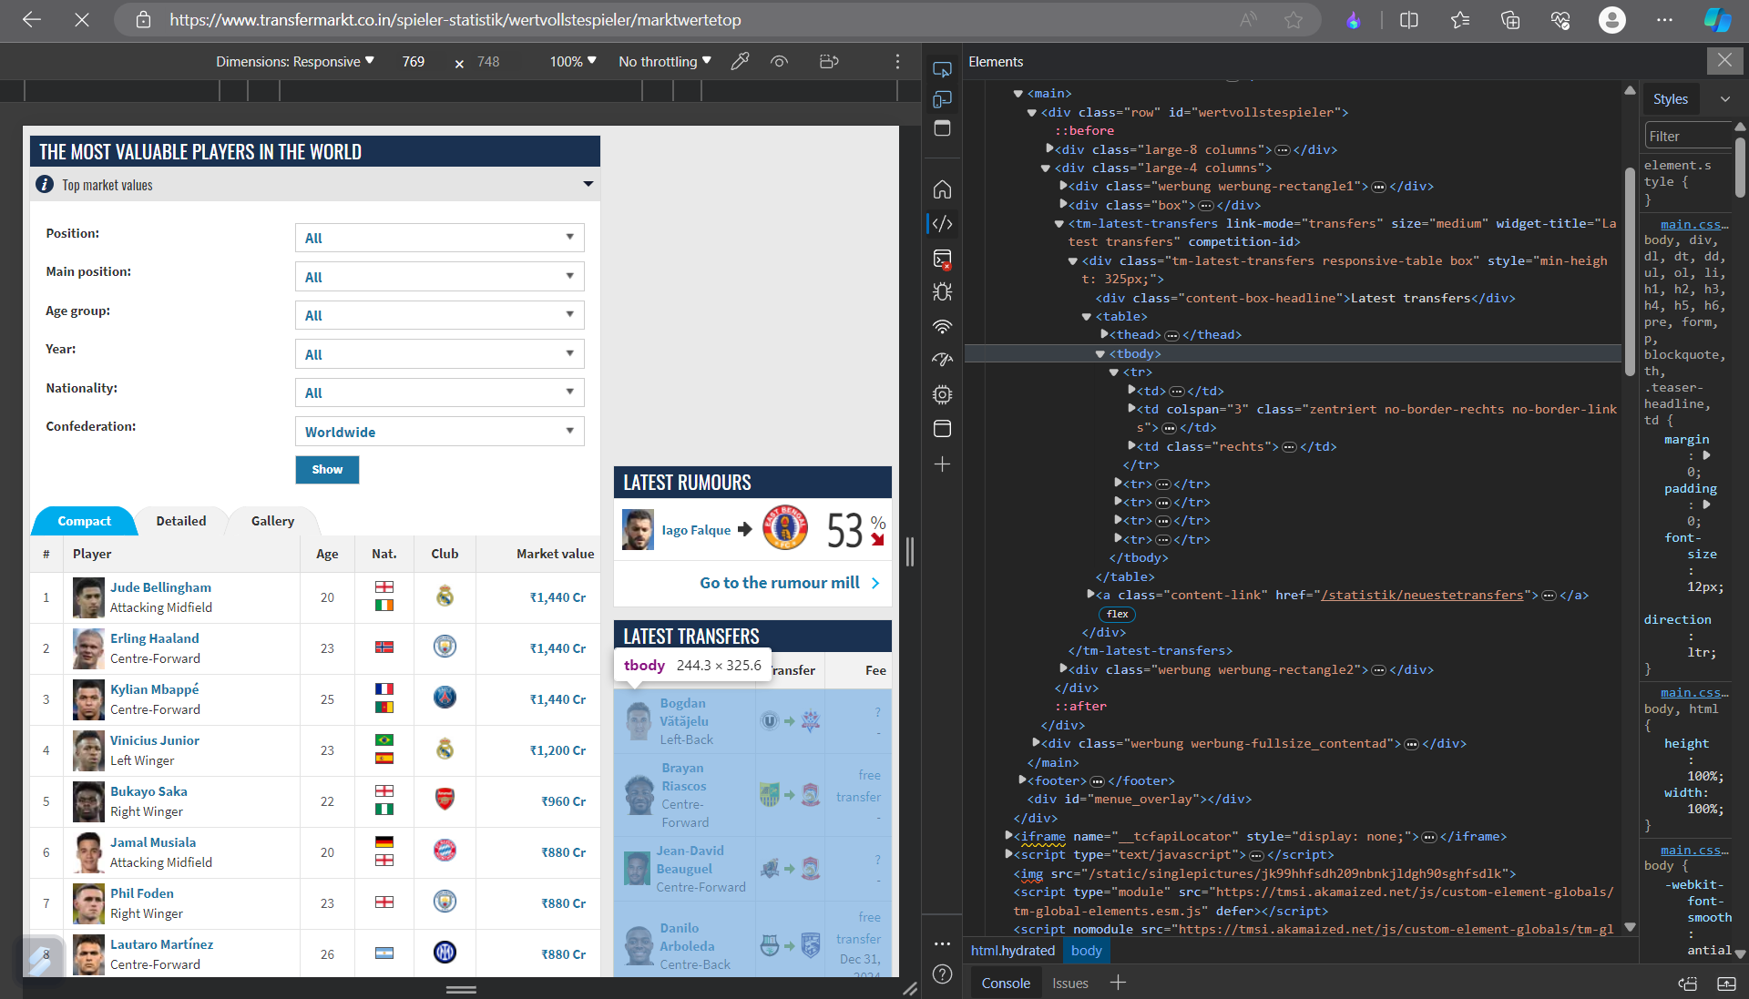
WEB SCRAPPING
1. FC rating
2. Transfermarket

Slide 4
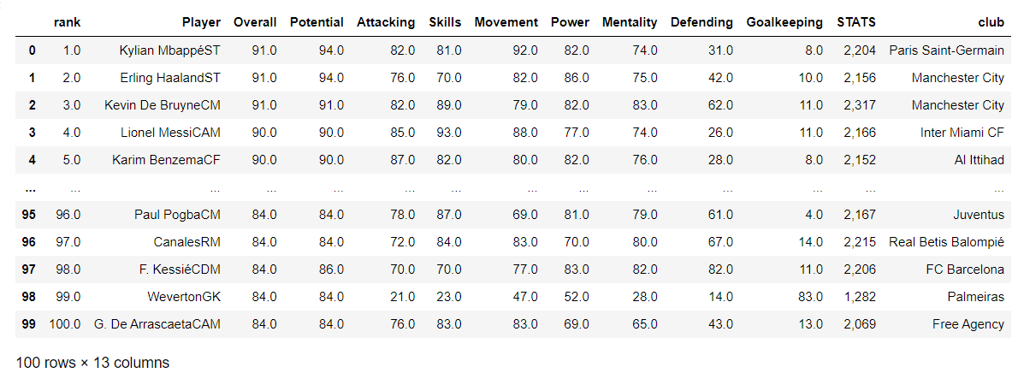
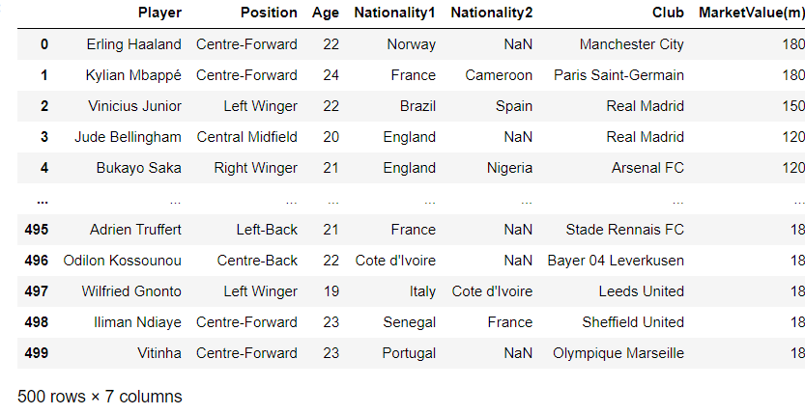
DataFrame
Defending
Power
Overall
Potential
Attacking
Skills
Movement
Player
Position
Age
Nationality 1 & 2
Club
Market value

Slide 5
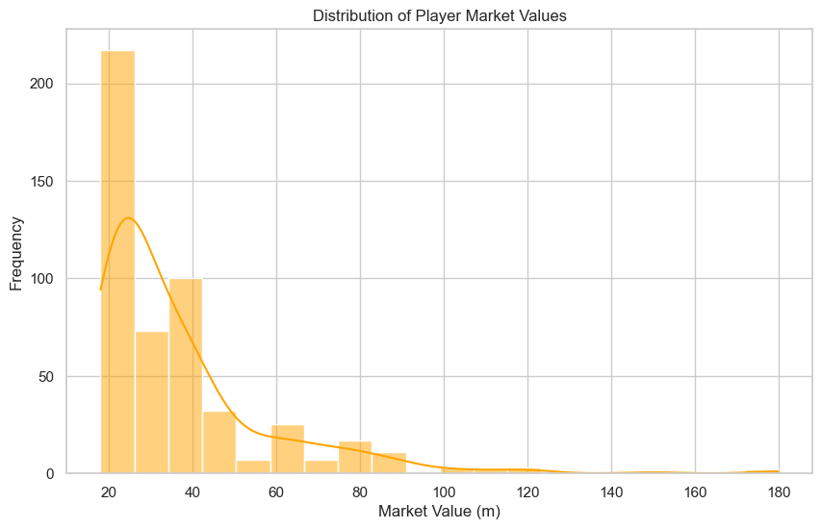
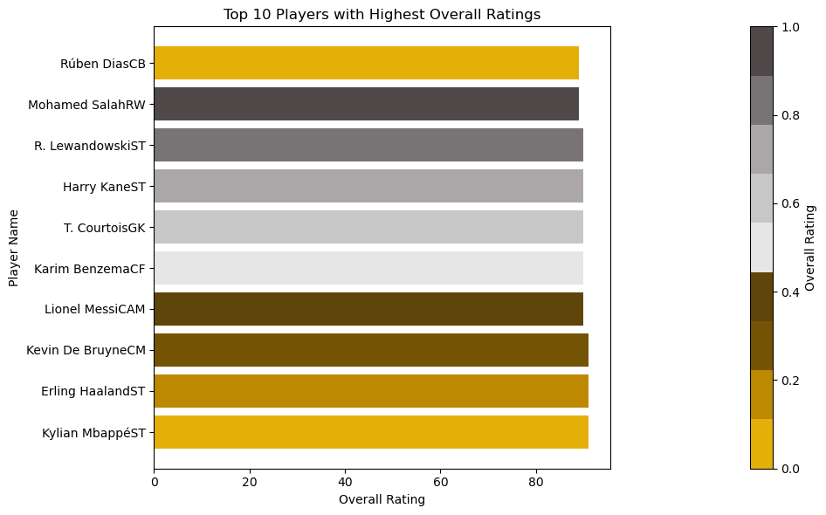
Top 10 Players with Highest Overall Ratings
1
Exploring Player Market Value Trends with Age
Distribution of Player Market Value (m)

Slide 6
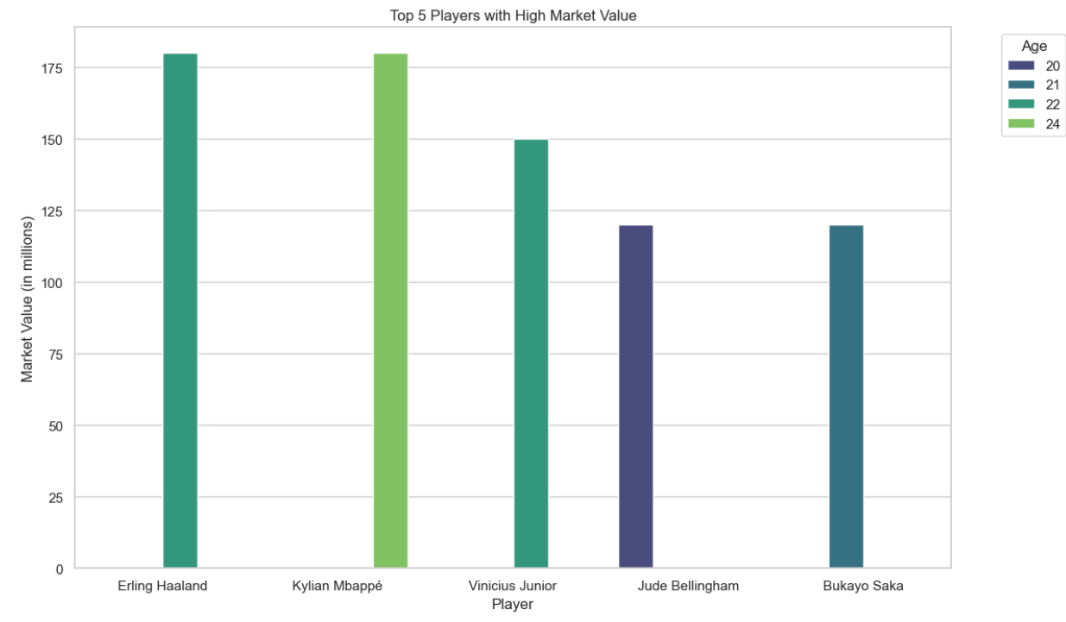
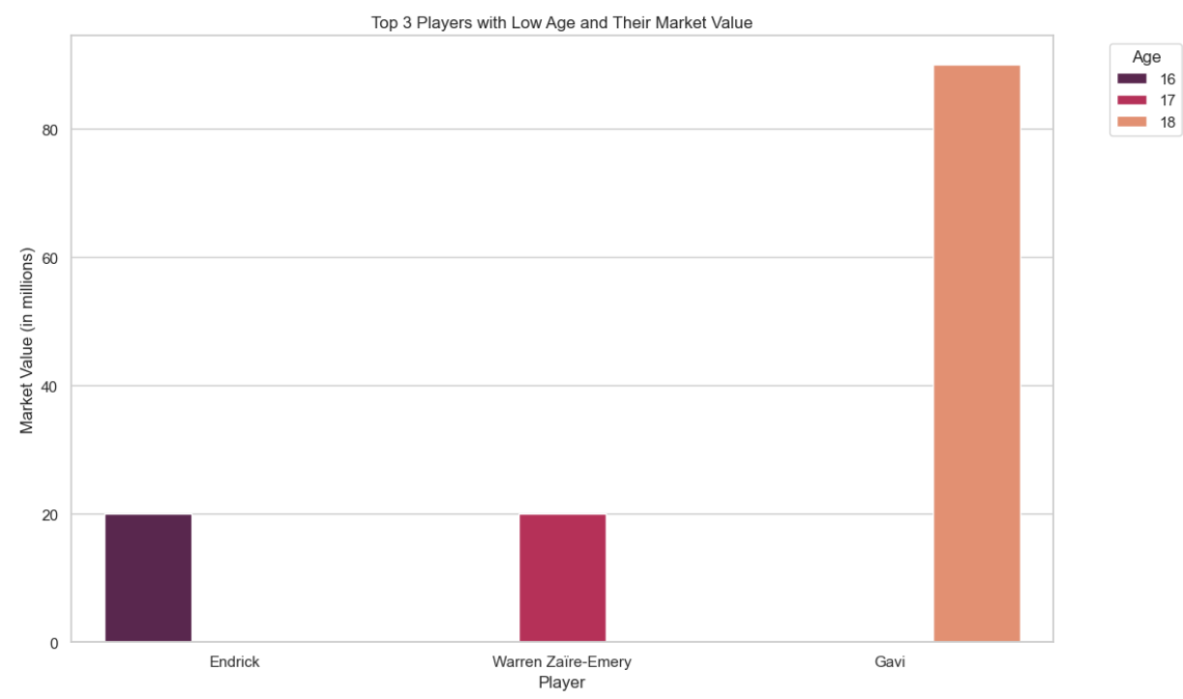
Top 5 Players with High Market Value
Erling haaland 180
Kylian Mbappe 180
Vencius Junior 150
Jude Bellingham 120
Bukayo Saka 120
Market Value
1.Endrick 16 20(m)
2.Warren Zaire 17 20(m)
3. Gavi 18 90(m)
Top 3 Players with Low Age and Their Market Value

Slide 7

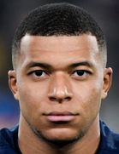
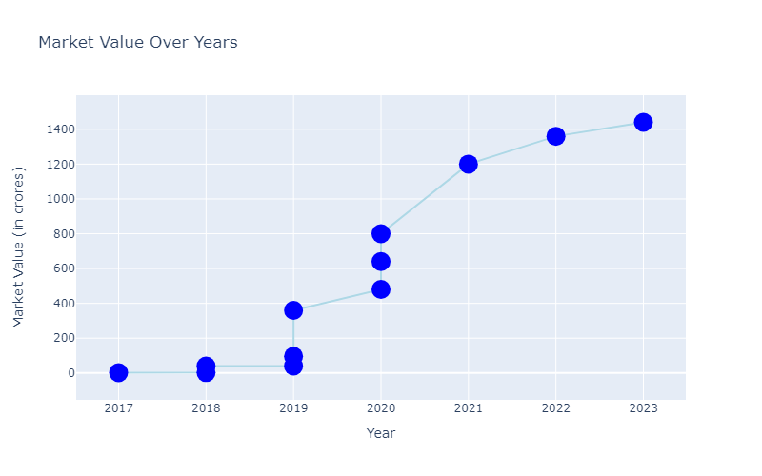
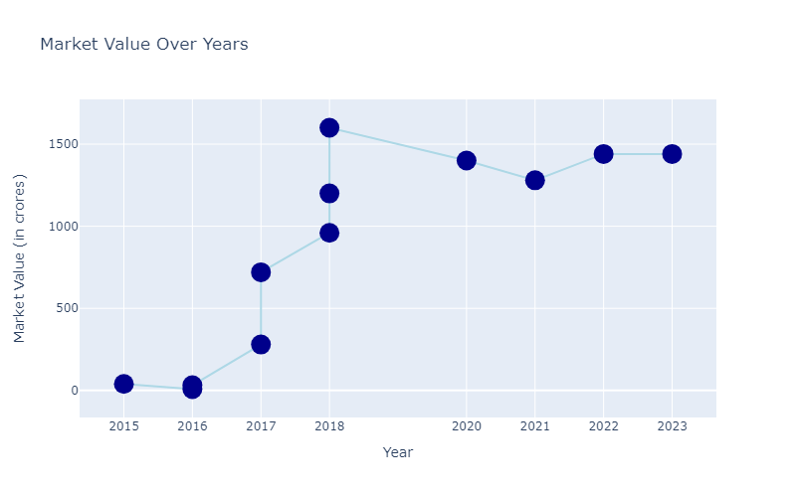
Longitudinal Analysis
Erling Haaland
Kylian Mbappe

Slide 8
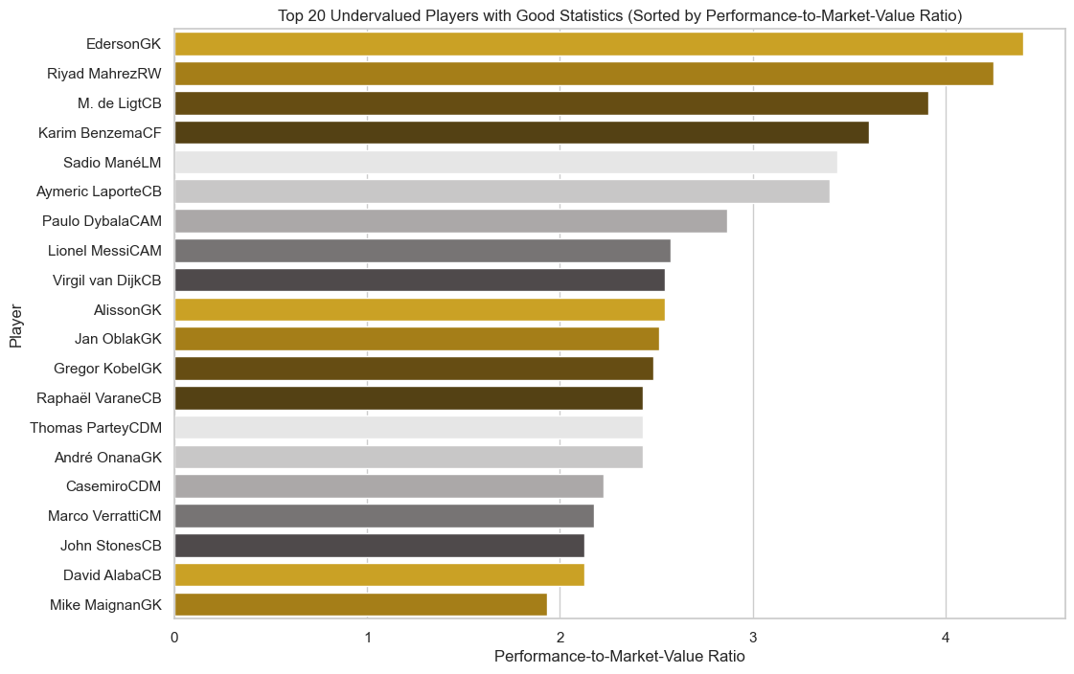
Unveiling Undervalued Players
2

Slide 9

Benefits of Identifying Undervalued Players
1
2
3
Enhanced Team Performance
Financial Gain for Clubs
Player Development Opportunities

Slide 10


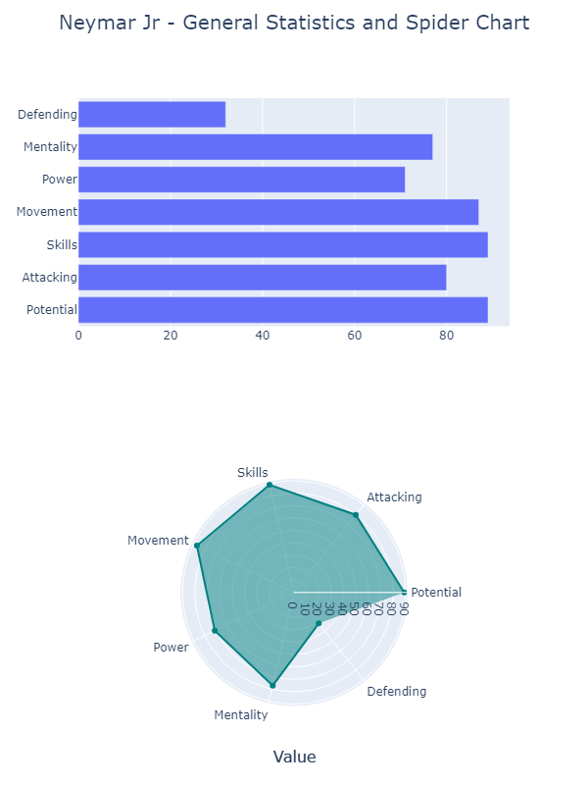
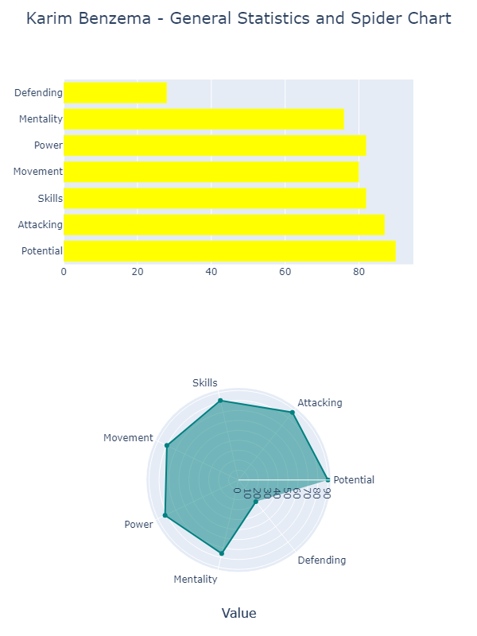
Undervalued player general stats

Slide 11
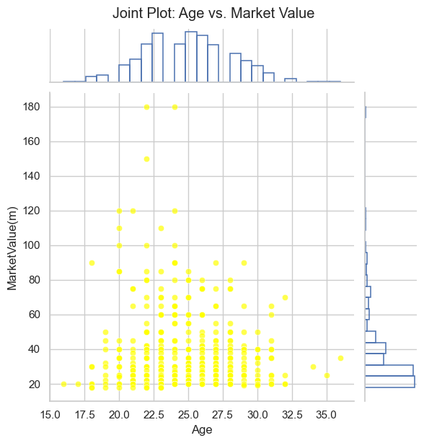
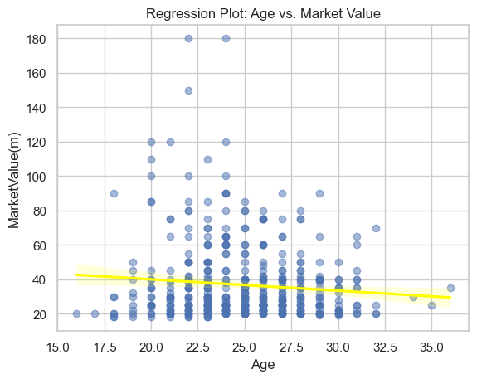
Age and Market Value
Negative Slope (Downward from left to right):
Indicates a negative correlation between the two variables. As one variable increases, the other variable tends to decrease.
The scatter plot reveals a significant concentration of data points between the ages of 20 and 27.

Slide 12
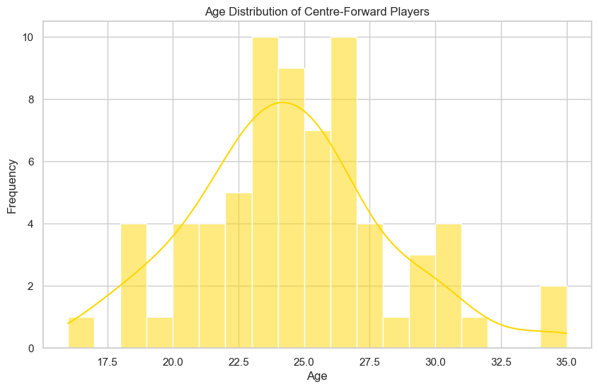
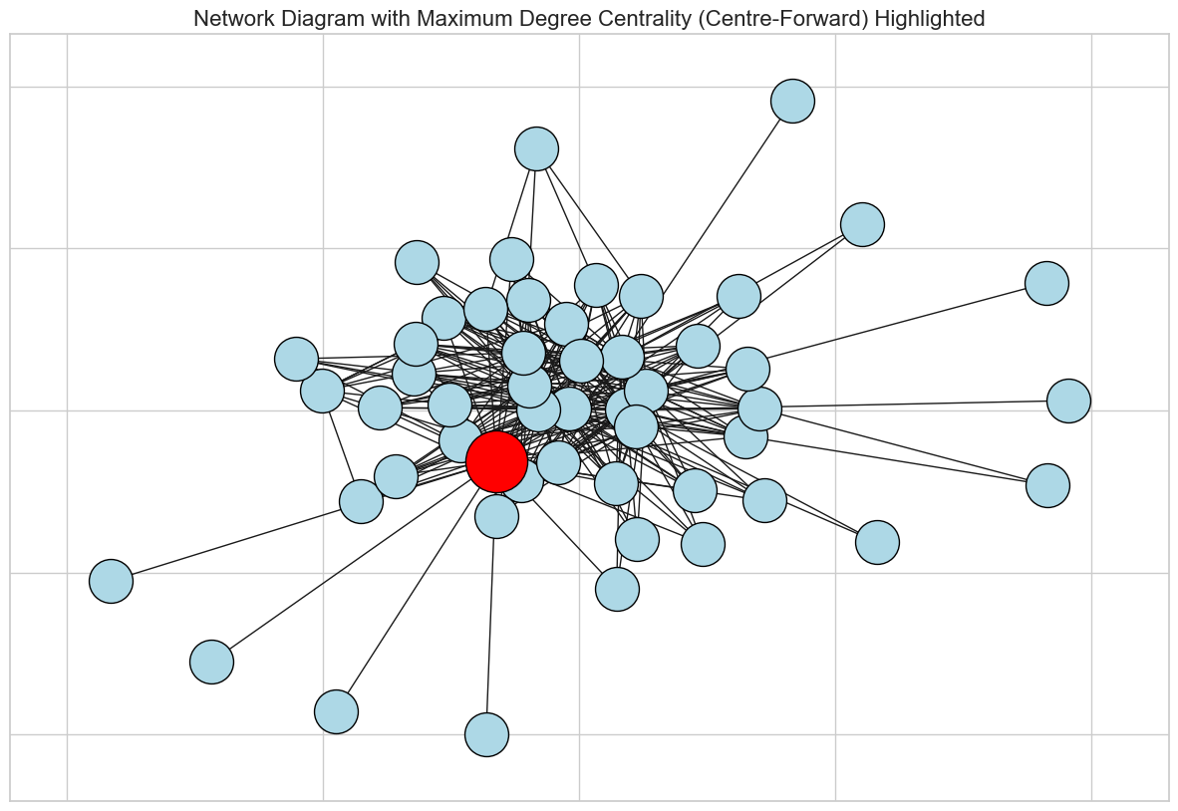
Insights by Position
Distribution of Centre-Forward Players
Centre-Forward
Centre-Forward" position is highly connected with various ages ranging from 16 to 35 and market values ranging from 18 to 120. This suggests that players in the "Centre-Forward" position exhibit a diverse range of ages and market values in dataset

Slide 13
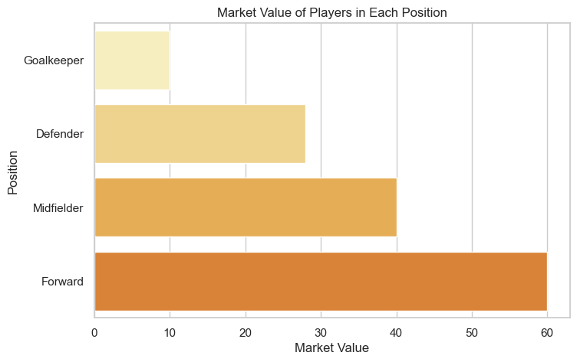

Slide 14

Age Distribution of Centre-Forward Players
Age 18-25
Emerging talents with strong scoring abilities
Age 26-30
Players in their prime with peak physical prowess
Age 31+
Experienced strikers with valuable game intelligence.
1
2
3

Slide 15

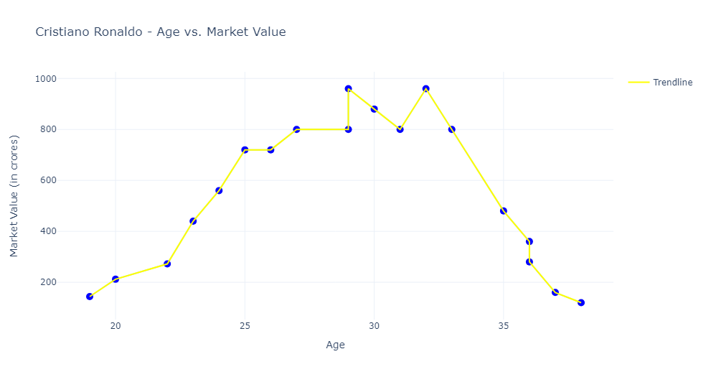
Highest Value 960 crores
At Age 29

Slide 16

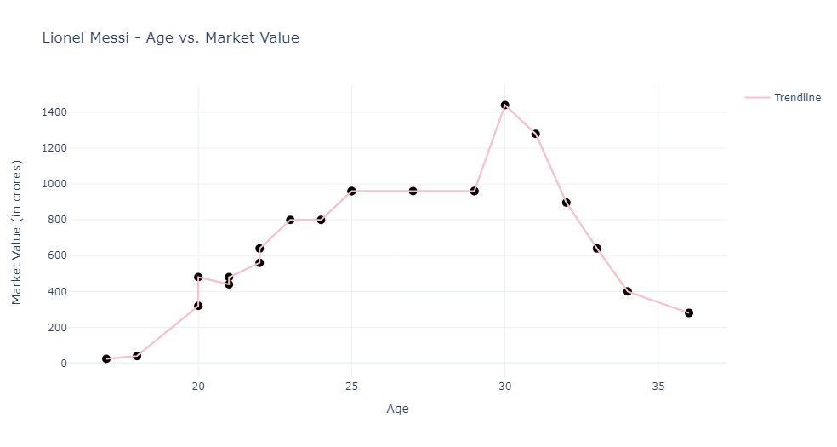
Highest Value 1440 crores
At Age 30

Slide 17
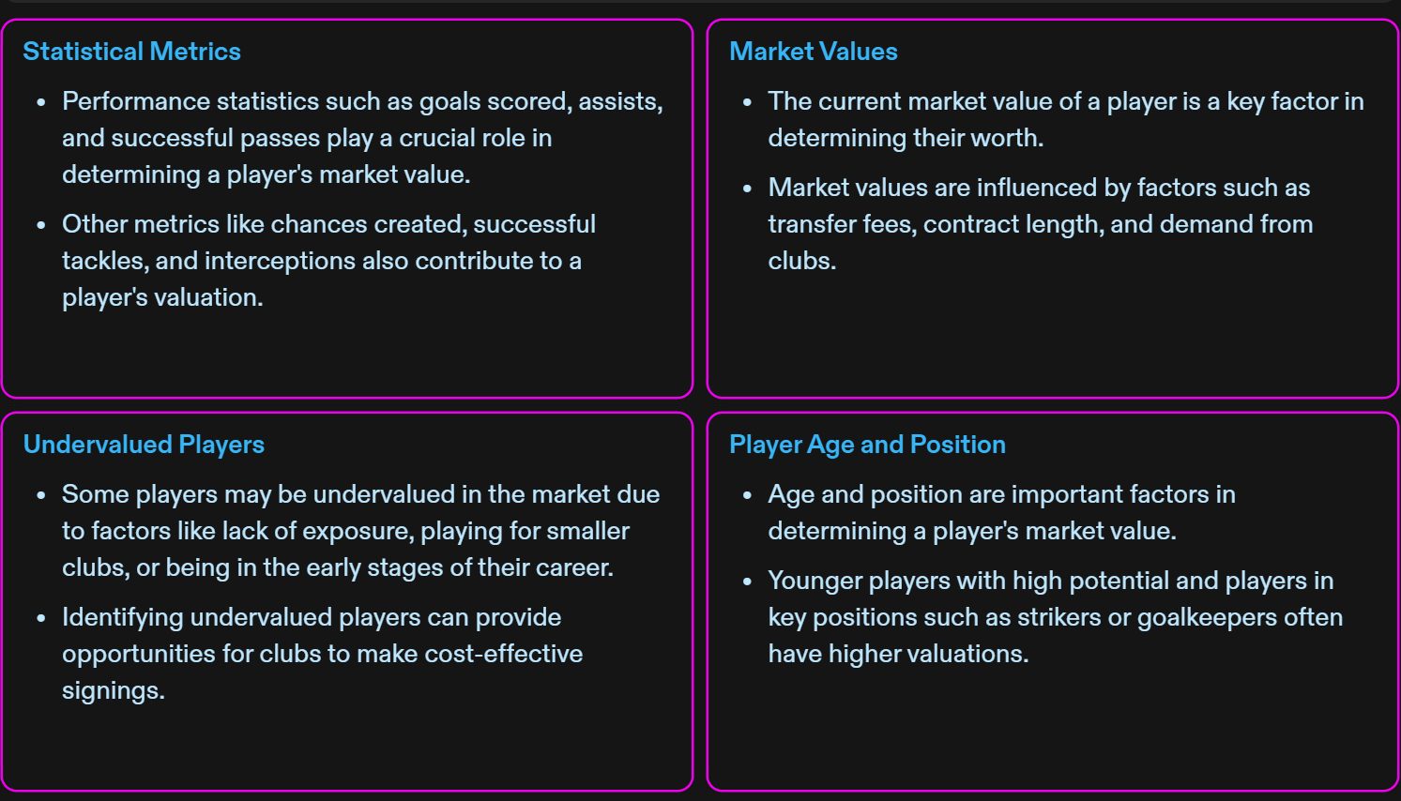
Factors Impacting Market Valuations

Slide 18
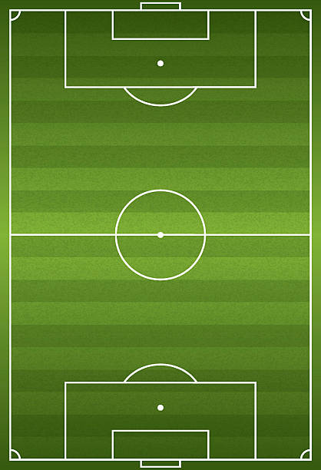
Conclusion and Key Takeaways
Strategic Approach
Employing a strategic model to identify undervalued players
Continuous Evaluation
Emphasizing the need for regular re-evaluation of player valuation
Enhanced Decision Making
Utilizing data-driven analysis for improved player selection.

Slide 19

I wanted to express my sincere gratitude for your invaluable guidance and support throughout the project. I truly appreciate the time and effort you've dedicated to helping me. Thank you for being an exceptional mentor.
@Innomatics @ Bhanu Prakash Pujala

